Slide 1
Intelligent financial planning hub
TEAM - 5

Slide 2
INTRODUCTION
The intelligent Financial Planning Hub is an advanced, technology-powered platform designed to streamline personal finance management.• By equipping users with tools to monitor expenses, evaluate spending habits, and establish financial objectives, the system delivers an organized approach to managing finances effortlessly.• This easy-to-use and efficient application helps individuals make well-informed financial decisions, promoting better financial habits and awareness while supporting effective future planning.

Slide 3
MILESTONE - 1
The system allows users to register, log in, and log out, with proper authentication mechanisms. Basic expense management functionalities, including adding, viewing, updating, and deleting expenses, are successfully implemented.

Slide 4
project overview
Features
Login : A secure page where you enter your credentials to access your financial account.
Register : The sign-up page to create a new account by providing personal information (name,email id and password). Set Budget : The page where you define your budget. Add Expenses : A page where you can log and categorize your daily or recurring expenses. View Expenses : A page displaying a detailed list of all your recorded expenses for review and analysis. Financial Report : A page that generates detailed reports on your expenses over the different categories.

Slide 5
project OVERVIEW
Features
Financial Dashboard : A comprehensive summary page with charts and graphs tracking your finances, including expenses and budgets. Update Budget : A page to adjust or revise your existing budget based on changing financial goals or circumstances. Change Password : A secure page to update your password for enhanced account protection. Edit Username : The page where you can modify your username for easier identification or personalization.

Slide 6
project METHODOLOGY
Backend Technology:
The project employs the Django framework, ensuring secure and efficient handling of user authentication, expense management, and financial reporting. Django's scalability supports real-time updates and robust database interactions.
Programming Language:
Python serves as the primary programming language, enabling seamless data processing, financial calculations, and integration with visualization tools.

Slide 7
project METHODOLOGY
Frontend Development:
The user interface is developed using HTML, CSS, and JavaScript, offering a responsive design for various devices. Dynamic elements and interactive components enhance the user experience.
Key Focus Areas:
Security: Protecting sensitive financial data through robust authentication and validations.
Scalability: Supporting a growing number of users and expense data.
User Experience: Ensuring an intuitive interface with clear navigation and functionality.

Slide 8
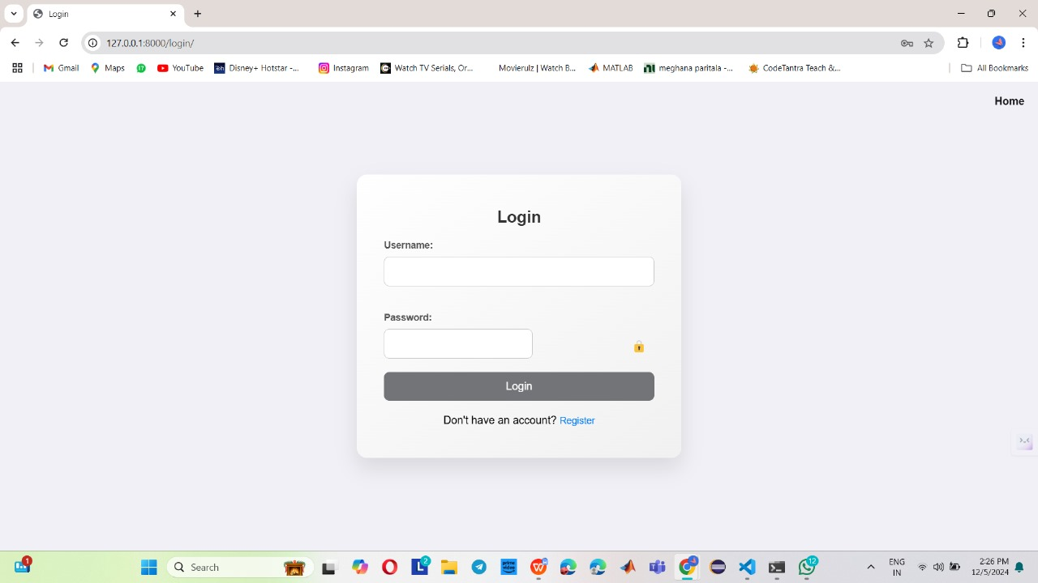
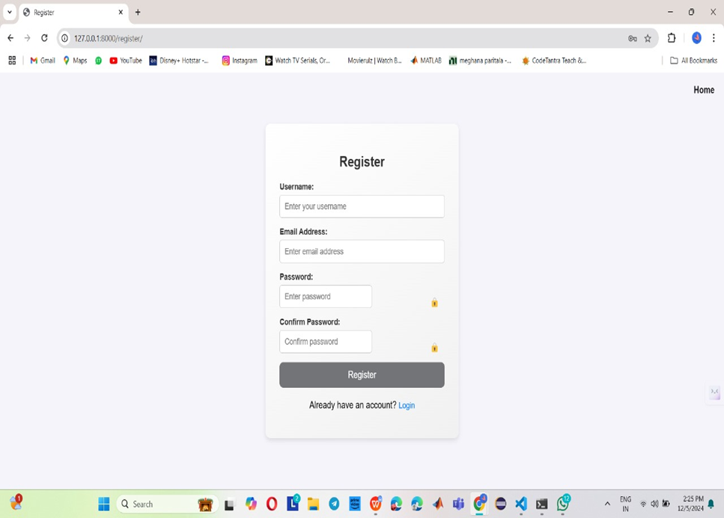
Login
Register

Slide 9


HOME
PROFILE

Slide 10
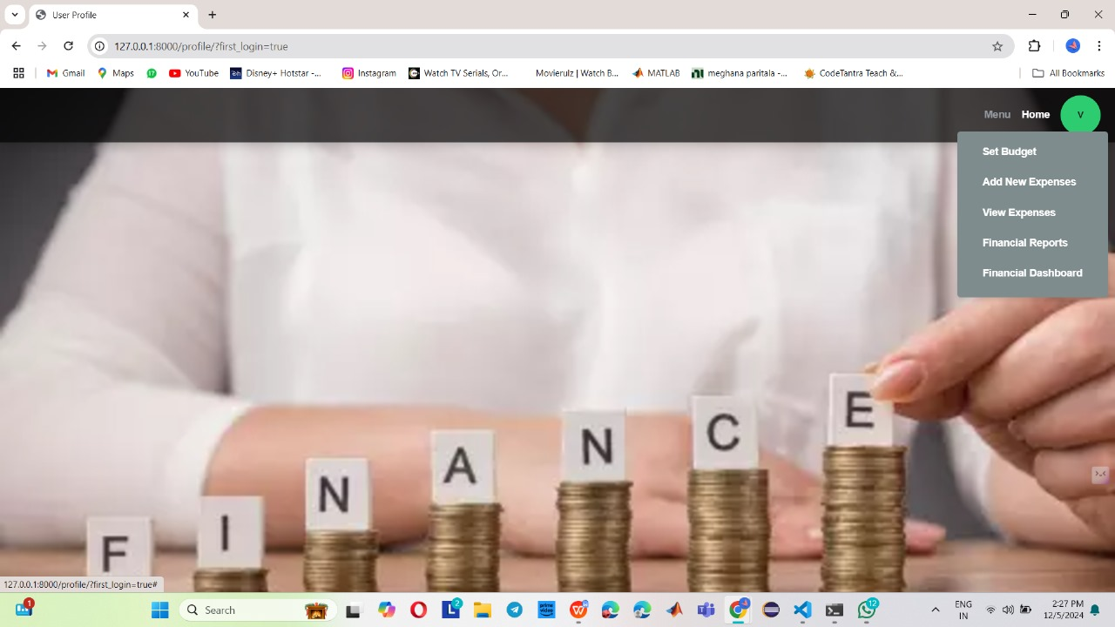
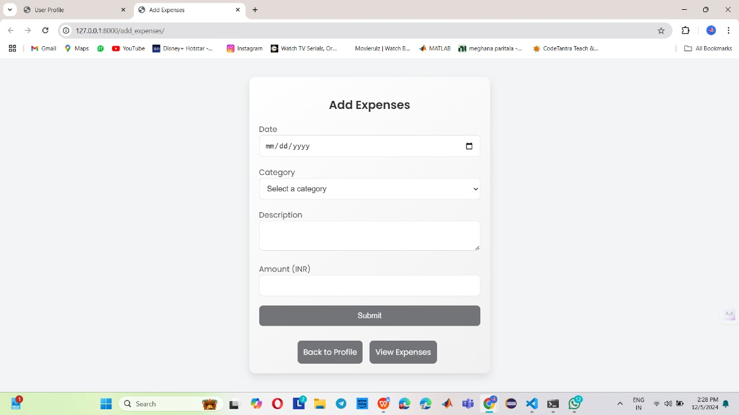
MENU
ADD EXPENSE

Slide 11
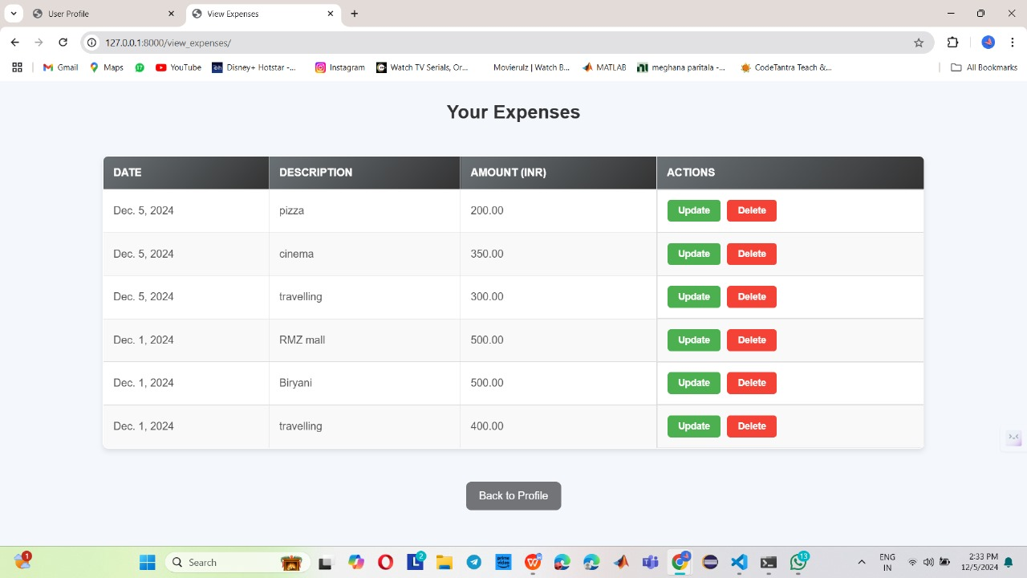
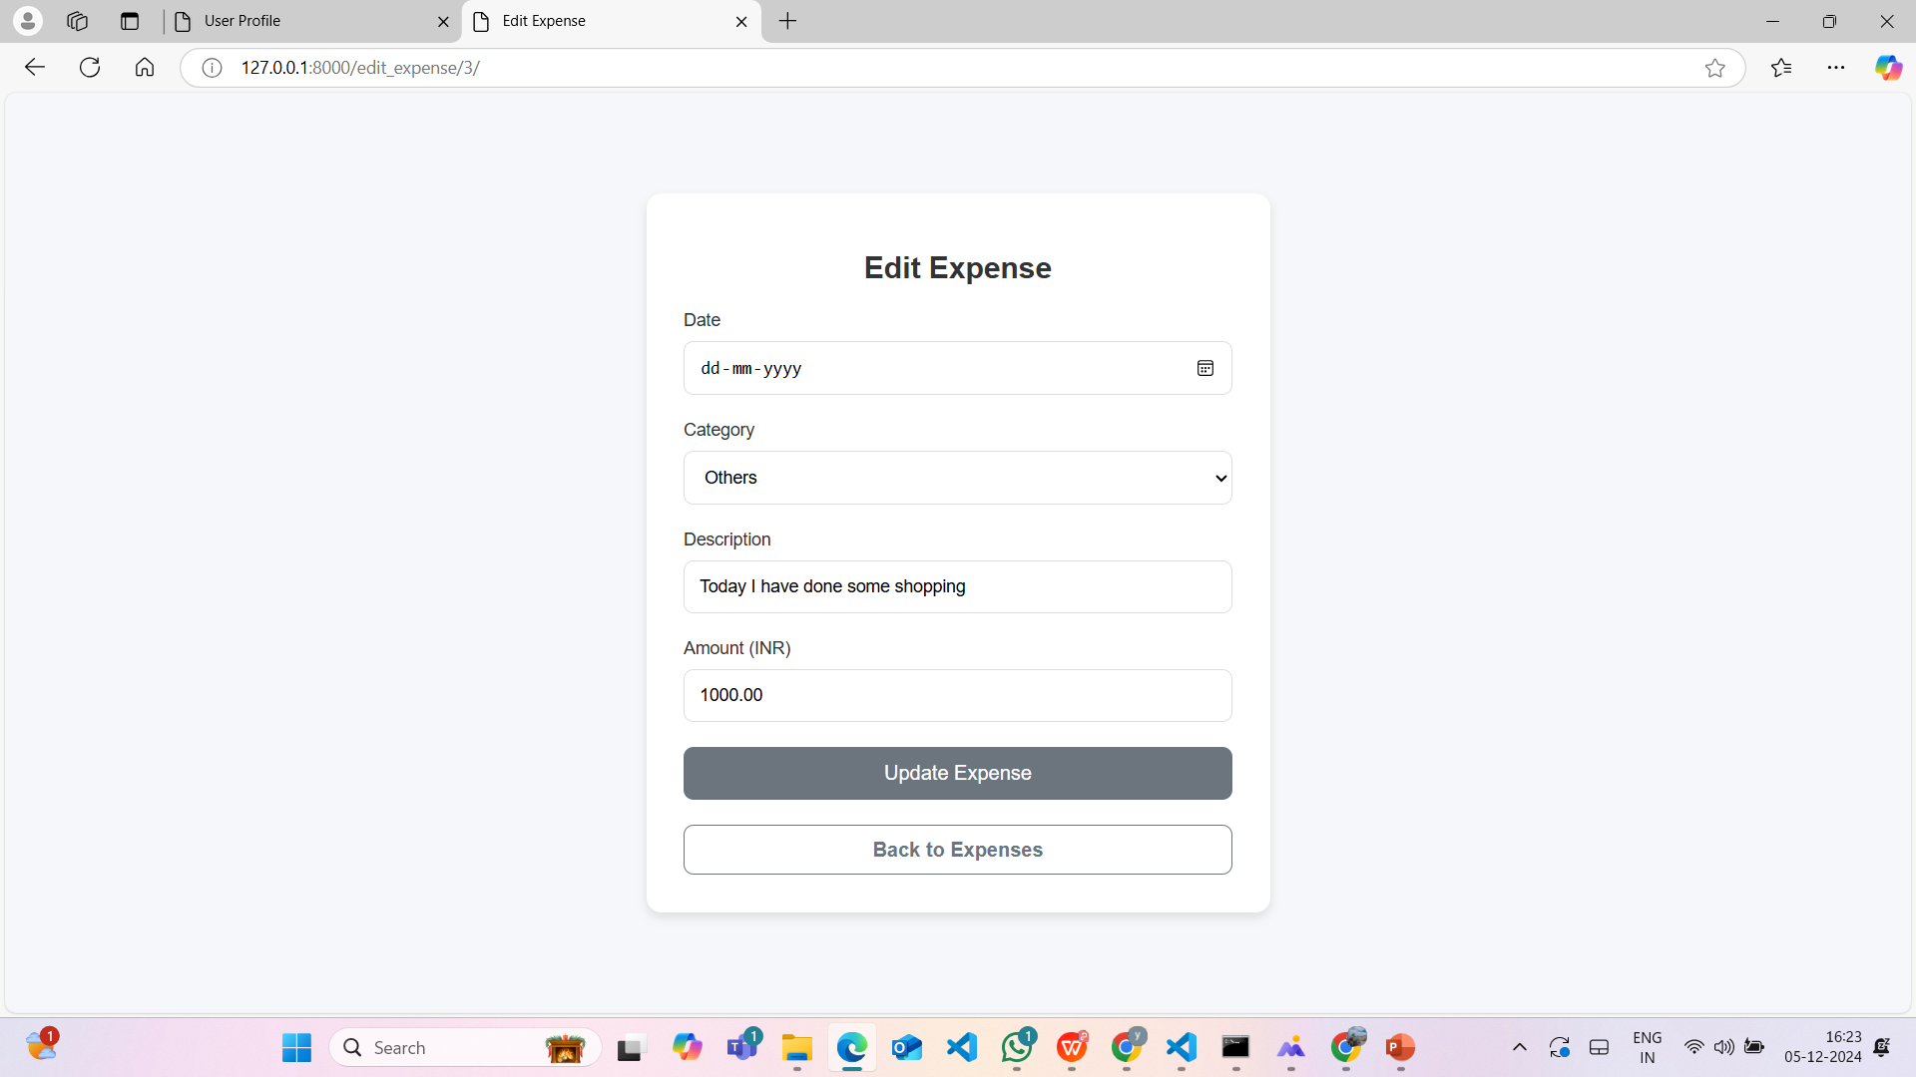
VIEW EXPENSE
UPDATE EXPENSE

Slide 12
MILESTONE - 2
Financial reporting features are successfully implemented, including the ability to export reports in PDF format. The system provides accurate calculation and display of financial summaries and visualizations.

Slide 13
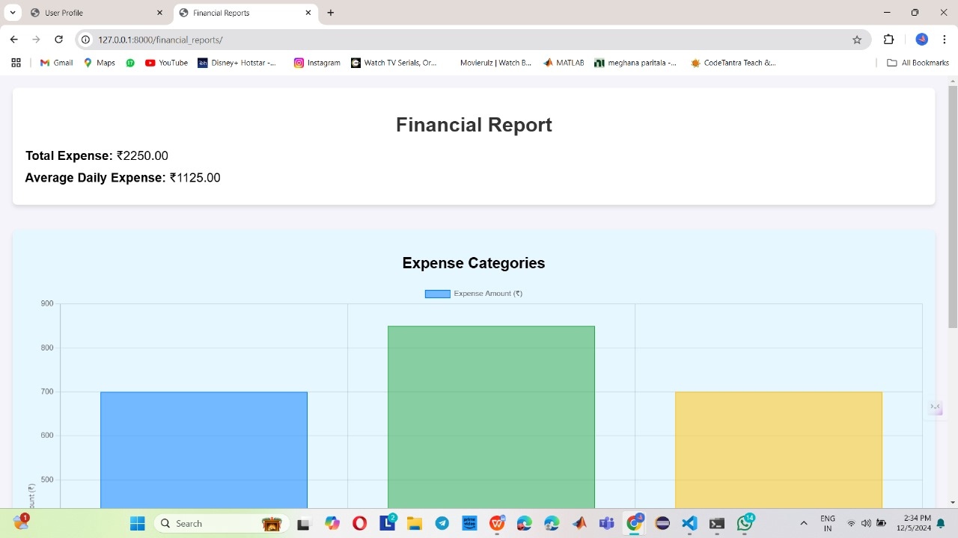
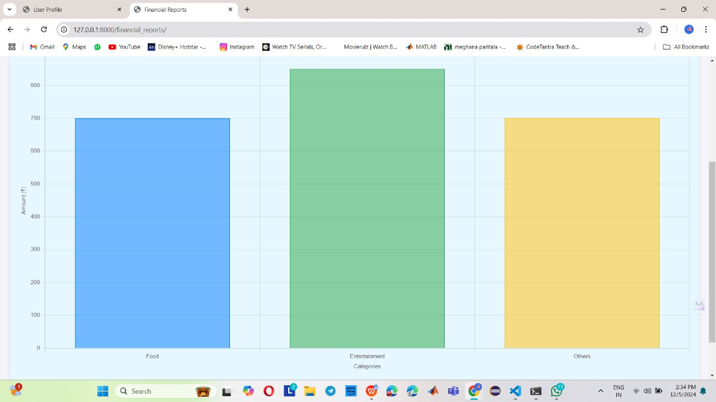
FINANCIAL REPORTS

Slide 14
MILESTONE - 3
A financial dashboard visually represents financial data, providing insights into budgets, expenses, and transactions using charts and tables. The update budget feature allows users to adjust their spending limits, ensuring better financial planning and control. Together, they enhance decision-making and promote effective management of personal or organizational finances.

Slide 15
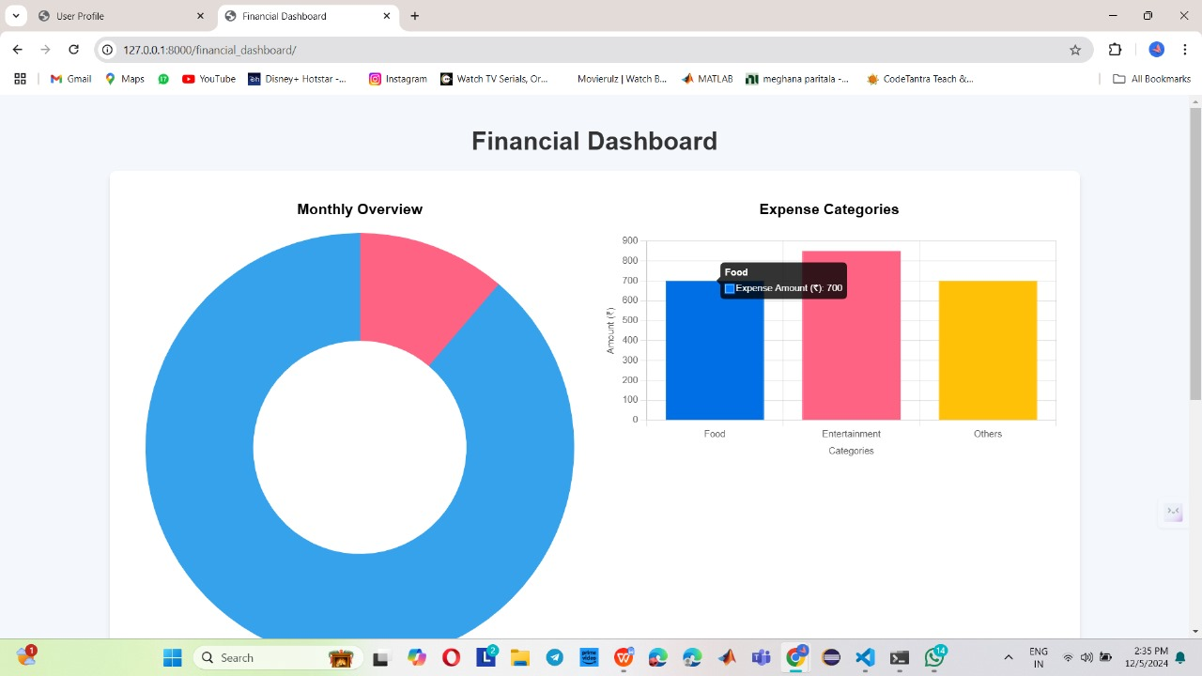
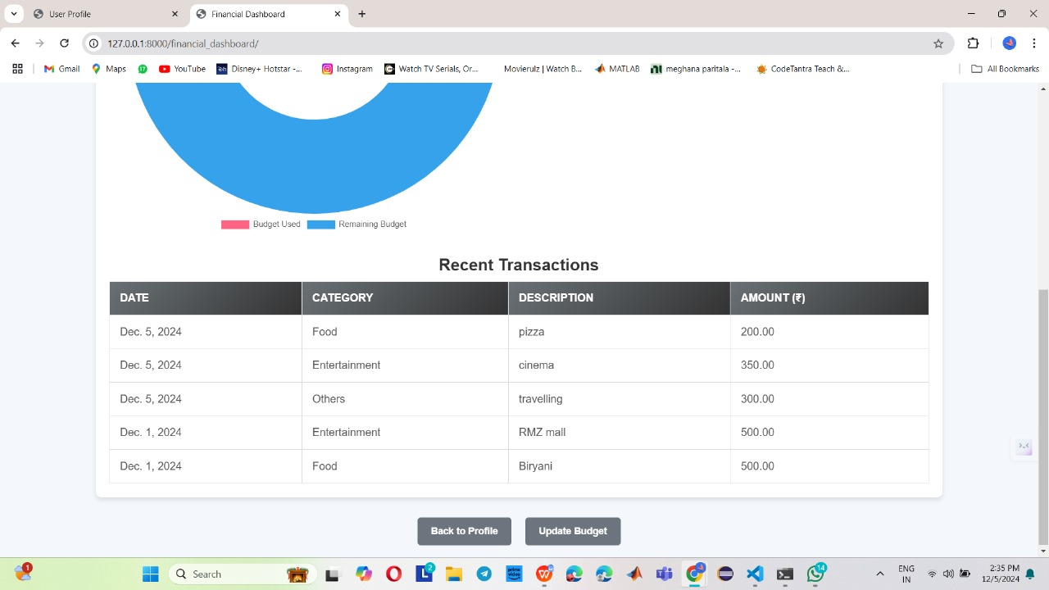
FINANCIAL DASHBOARDS

Slide 16
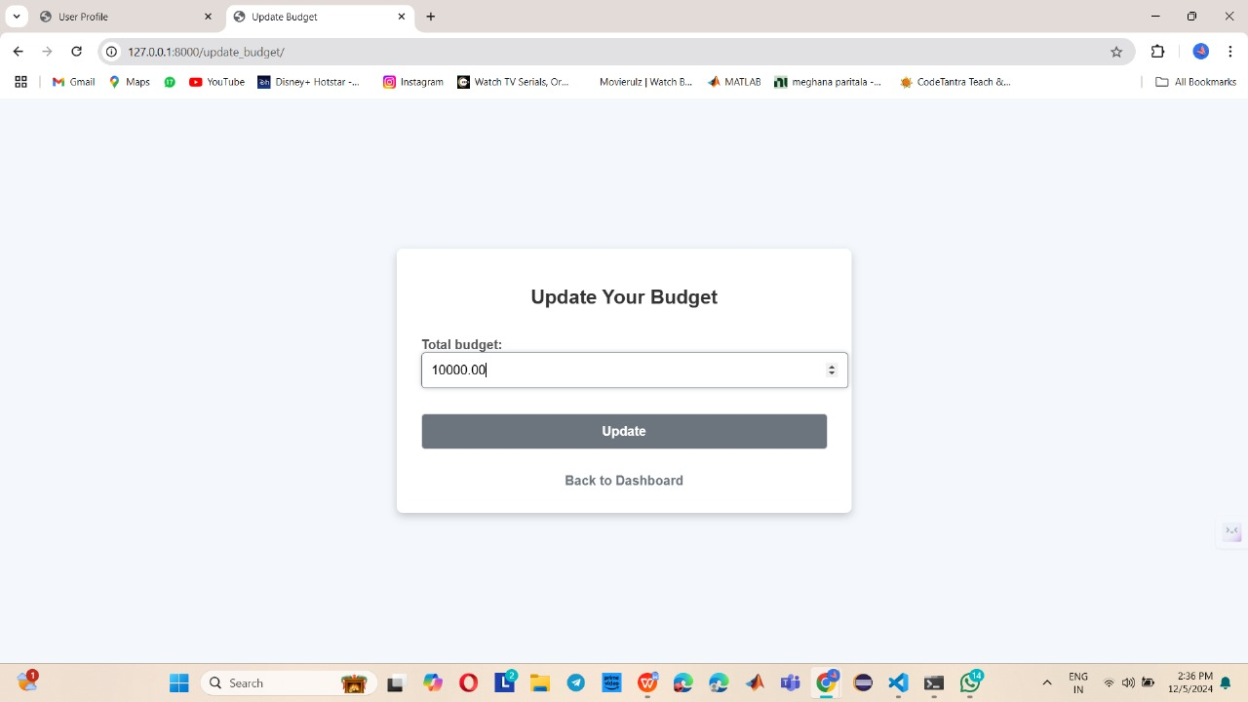
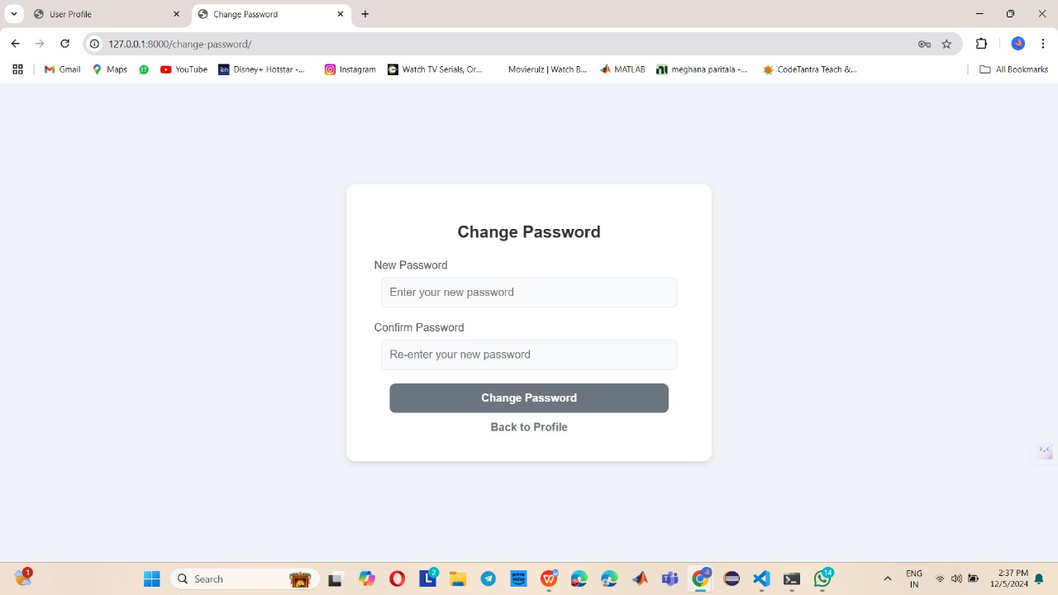
UPDATE BUDGET
CHANGE PASSWORD

Slide 17
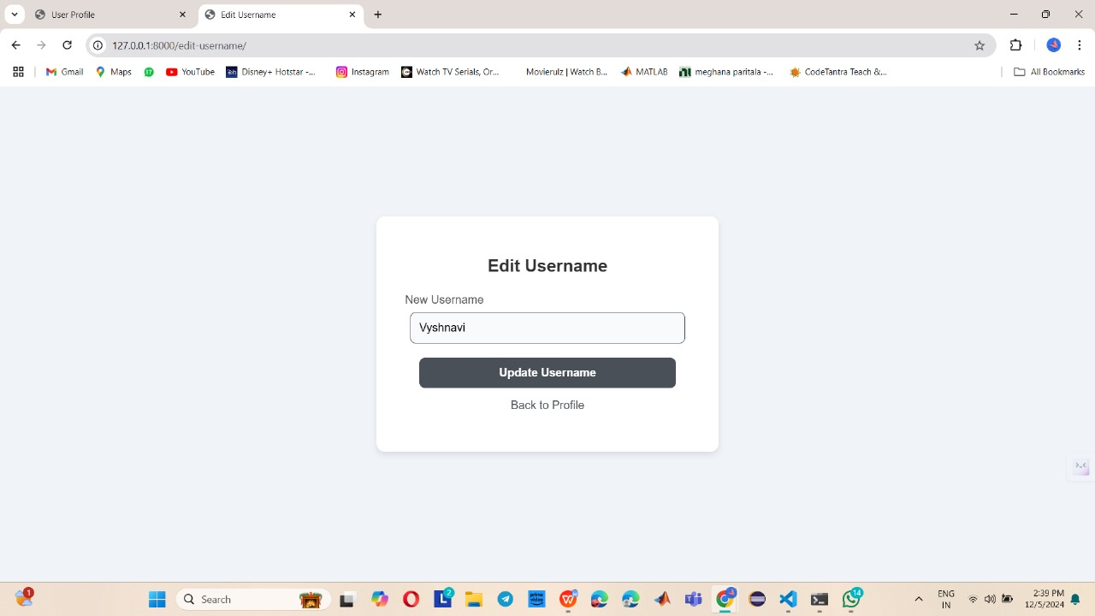
UPDATE USERNAME

Slide 18
CONCLUSION
The Intelligent Financial Planning Hub aims to redefine personal finance management by offering a blend of simplicity and intelligence. By integrating key functionalities like expense management, reporting, dashboard visualization, and budget planning, the hub equips users with the tools to gain complete control over their finances. The system’s ability to generate insights, visualize trends, and send alerts ensures that users remain informed and proactive about their financial health. With a focus on usability, accuracy, and efficiency, this hub aspires to be a trusted companion in achieving financial well-being for individuals in an ever-evolving economic landscape.

Slide 19
TEAM MEMBERS
Y. Baby Ramya
Kamalesh Janapa
P. Venkata Sai Meghana
Yacham Sujitha

Slide 20
THANK YOU

